Slide 1
www.MINEPORTAL.in
ONLINE TEST SERIES FOR
GATE MINING
COAL/METAL FIRST/SECOND CLASS
COAL INDIA MT MINING EXAM
OVERMAN/SIRDAR EXAM
OTHER PSU MANAGEMENT TRAINEE EXAM
FREE STUDY MATERIAL/VIDEO LECTURES
ONLINE ORDER MINING BOOKS
CALL/WHATSAPP-8804777500 www.fb.com/mineportal.in

Slide 2

CONTROLLED BLASTING TECHNIQUES

Slide 3
OBJECTIVES
To preserve the natural strength of rock walls
To control overbreak at excavation limits
To reduce the dilution of ore in metal mines
To produce cosmetically appealing final walls

Slide 4
Techniques
Presplitting
Trim Blasting
Buffer Blasting
Muffled Blasting
Line Drilling

Slide 5

Presplitting
Utilizes a row of closely spaced, lightly charged blastholes at required place
Initial spacing be equal to the hole dia × 14 (m)
Presplit Load (kg) = (Bench Height × Spacing) / 2
Presplit Burden (m) = 50% of Normal Burden
The holes are detonated prior to the detonation of adjacent blastholes to create a fracture line
Expensive and labor intensive
Holes should not be stemmed unless air blast levels must be restricted
To achieve optimum results, short or no delay should be used between holes
Test designs in non critical areas before final designs are adopted

Slide 6
Trim Blasting
Other names: Smooth wall Blasting, Cushion Blasting
A line of lightly loaded holes with decoupling, drilled along the final line of excavation
Holes fired after the main production holes
Charging of hole is same as in Presplitting
Spacing is larger than in Presplitting as there is always horizontal relief
Hole diameter is same as used for production blast
Cartridge explosives having less than 50% of cross sectional area of the bore hole are used

Slide 7
Buffer Blasting
Often used in conjunction with Presplit blasting
Hole dia and depth are same as in main blast
Charges in the last row are smaller and decoupled.
It is a practice, wherein fresh blast is undertaken without completely clearing the muck of the previous blast
Piperwar Opencast Coal Mine

Slide 8
Muffled Blasting
Covering material to contain flying fragments-
Heavy covering material-
  Rubber blasting mats
  Logs shackled together
  Wire mats
  Iron ring mats
Splinter-protective material
Industrial felt mats
Reinforcing nets
Wire nets
Tarpaulin
Plastic-nylon cloth
The Columbus mat

Slide 9
Line Drilling
The drilling is used when no detonation is tolerated along the final wall
Used in soft structured ground or for vibration control
Involve drilling a line of holes with close spacing (6 to 12 hole dia) .holes does not charged.(Empty holes =buffer holes)
Standard production sized holes are used
The buffer holes should be drilled 50 -75% of Normal burden and charges also be reduced to 50% of the normal with decking
The spacing of buffer holed should be 75% of normal

Slide 10
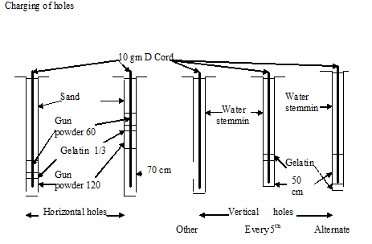
DIMENSION STONE BLASTING

